Slide 1

Bird with a Broken Wing
Hang in there, Marco!

Slide 2
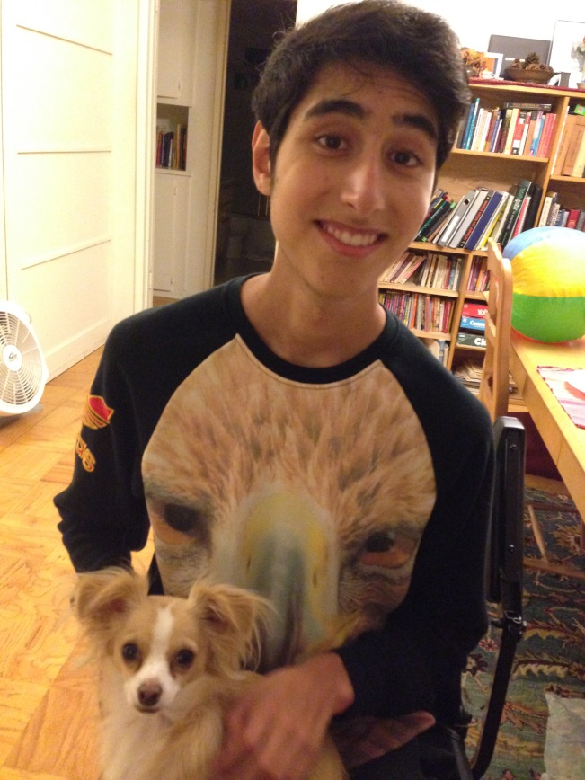
Hello friends,
We are raising funds to try to save Marco, a much loved son, a devoted brother, a loyal friend, a beautiful soul. Marco has been diagnosed with a rare and severe type of Muscular Dystrophy.
This has left him confined to a wheelchair, and on a breathing machine…

Slide 3
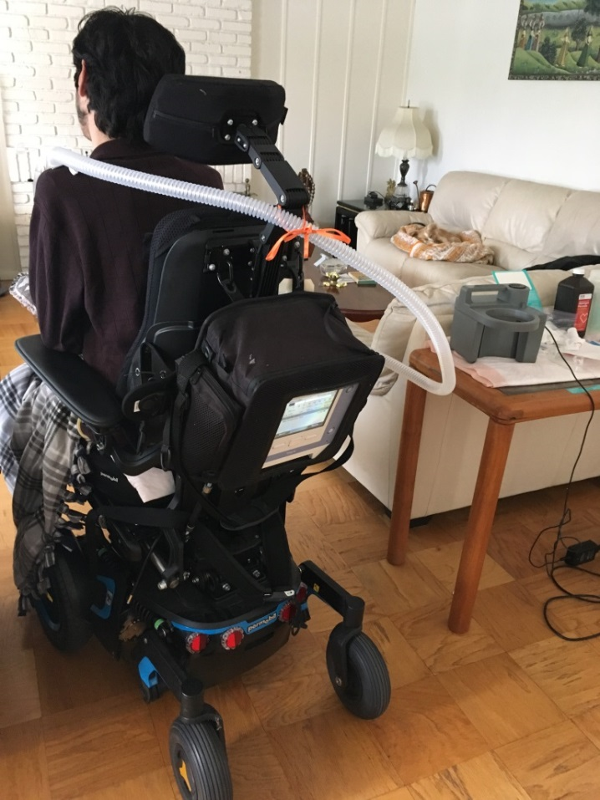
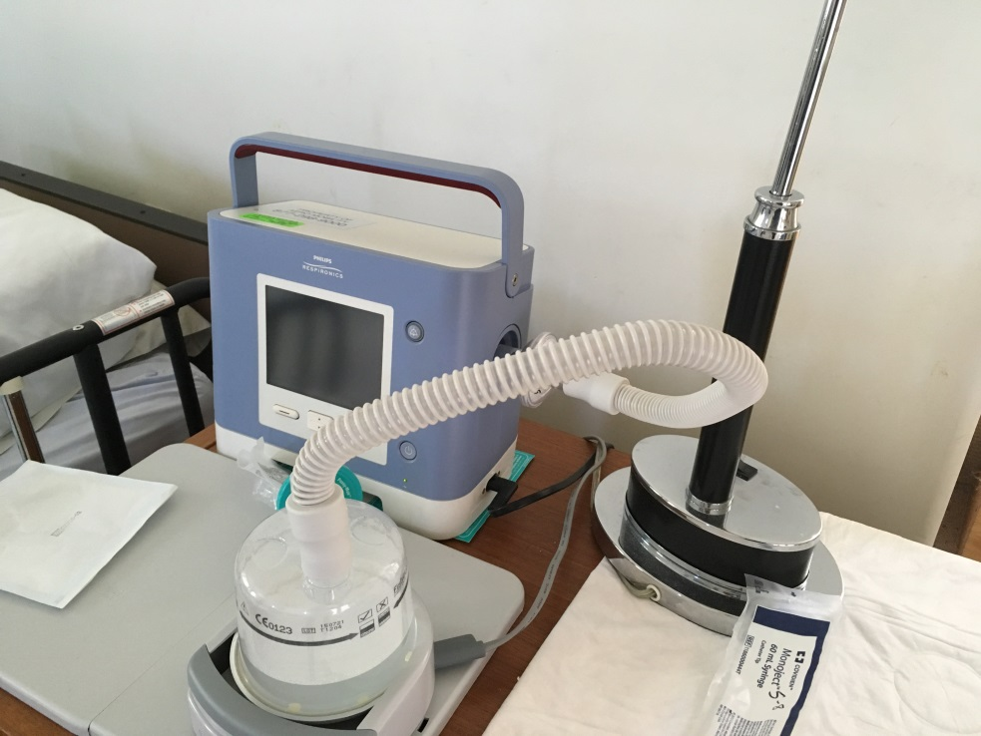
Imagine living with no treatment , no hope and knowing the condition is so rare that there is little incentive for research.

Slide 4
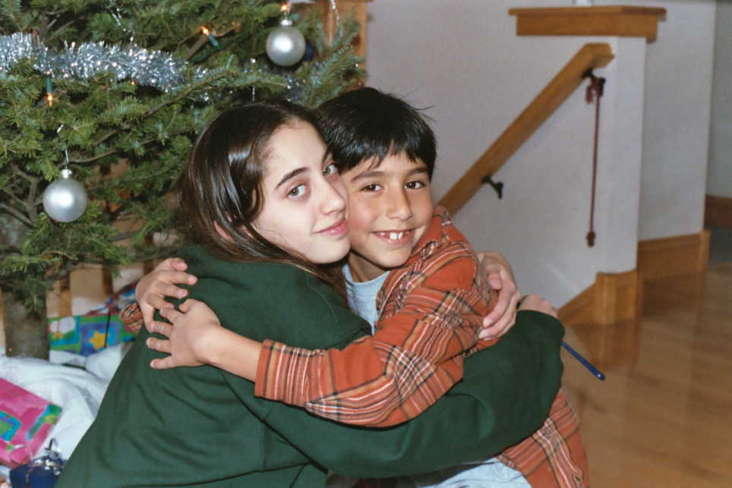
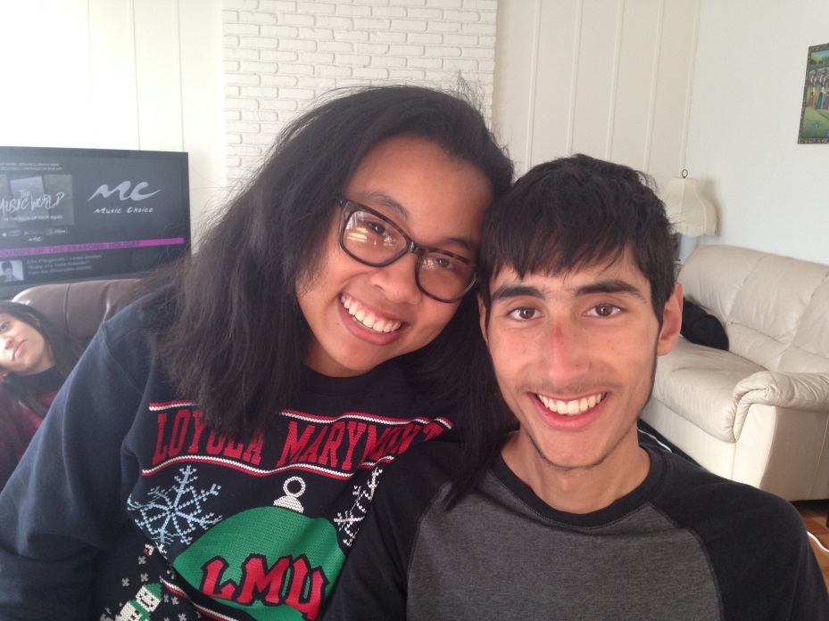
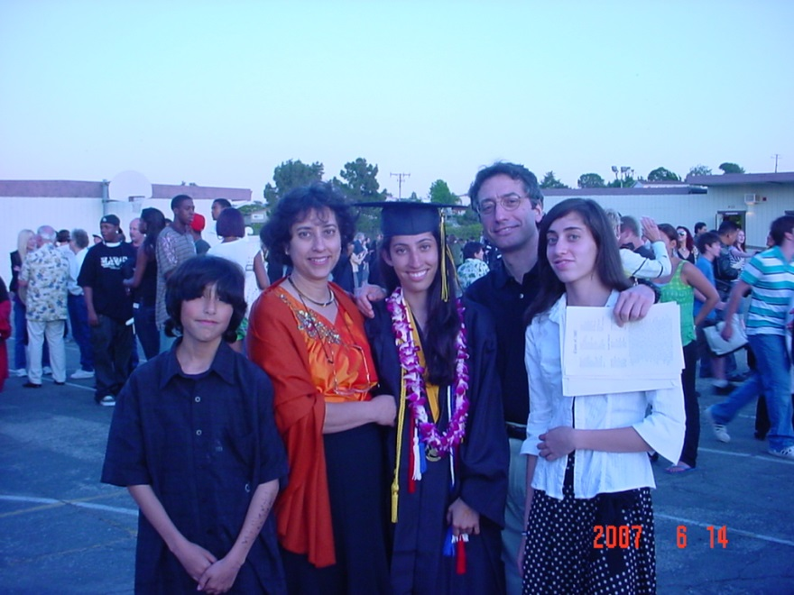
Marco’s story………………………
Marco was born in 1995, seeming a normal and lovely child. He has 2 older sisters, dad, mom, and Emily his girlfriend, and last but not least, Quinn, his dog

Slide 5
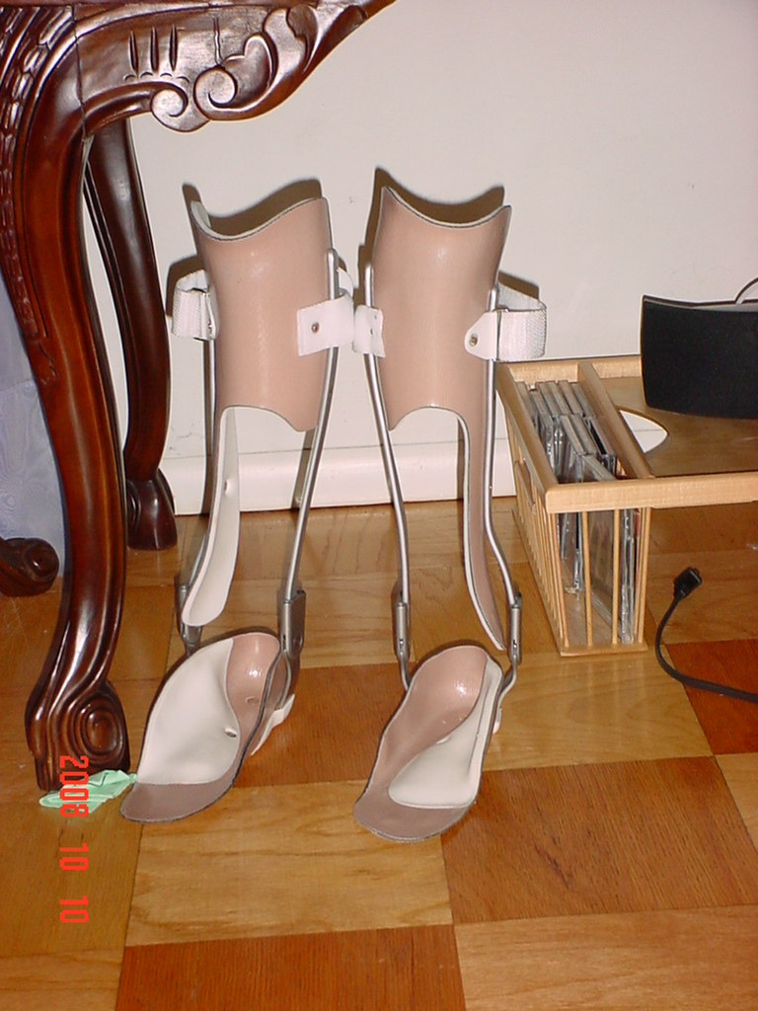
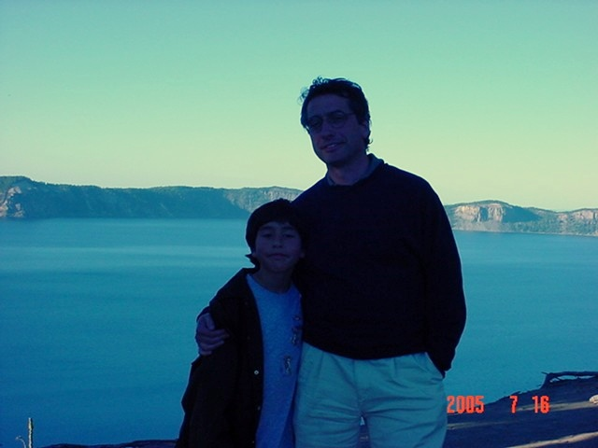
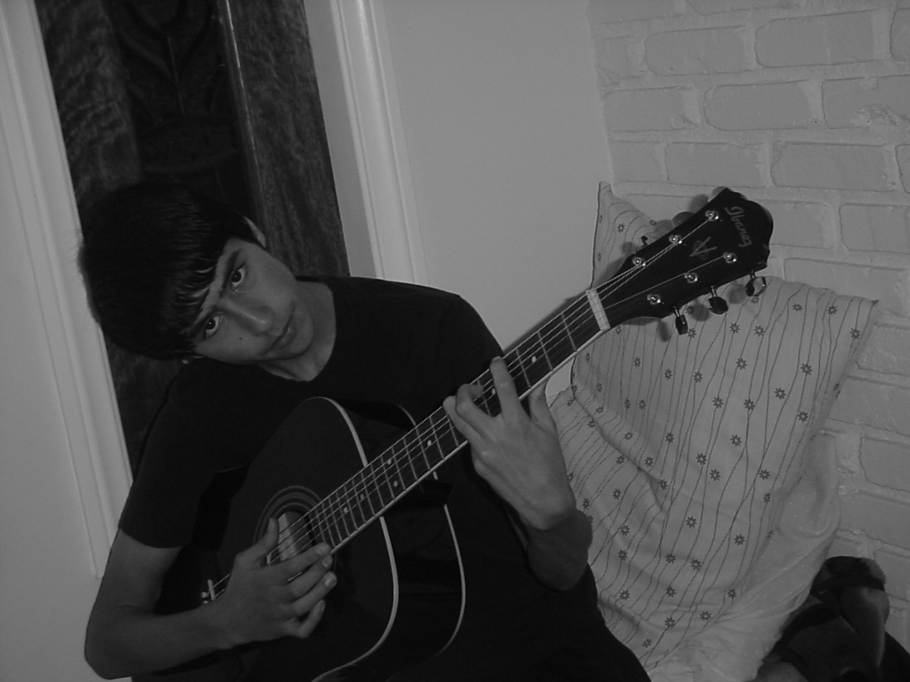
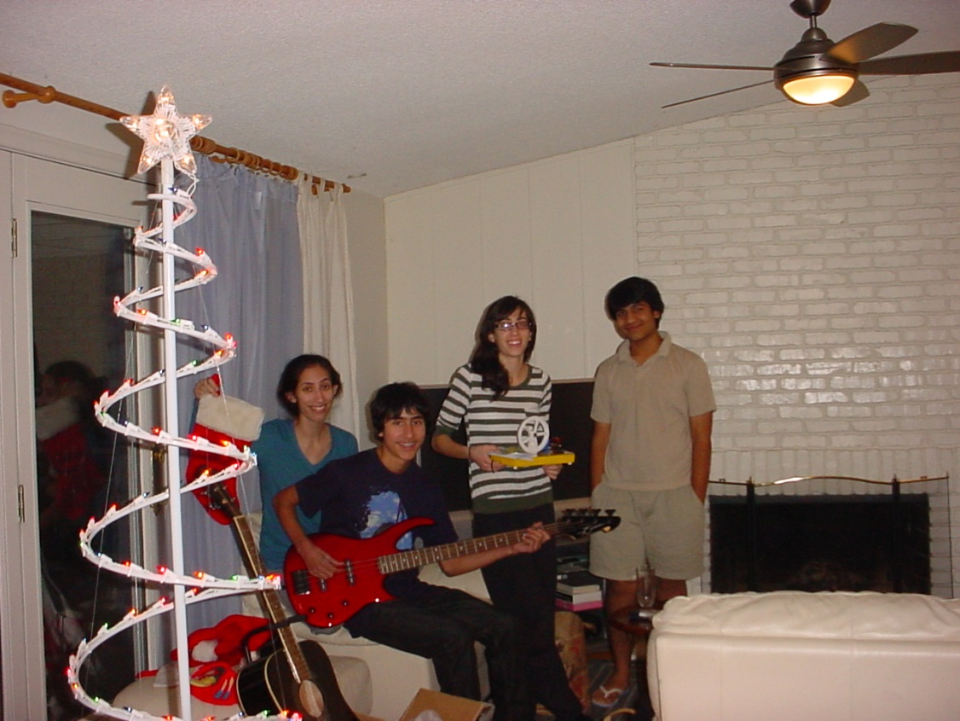

Slide 6
As the years passed, Marco's wings got clipped…...
Around age 4, he showed started showing neuromuscular peculiarities - he could not sit cross legged on the floor, and could not grip the ropes of the swing set.
But he kept trying to keep up with his peers....

Slide 7
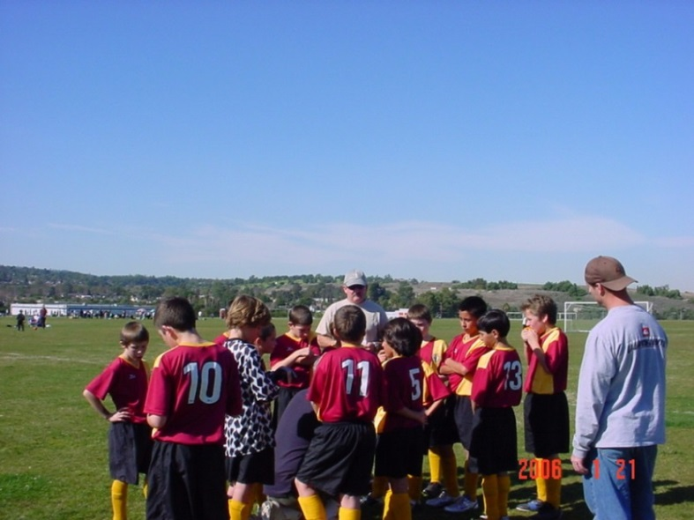
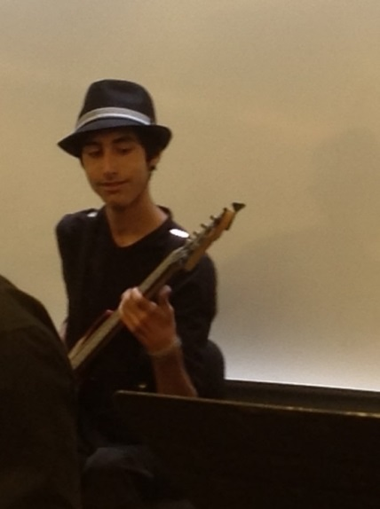
He enthusiastically played soccer (age 8-14) until he couldn't run anymore……
He played Jazz Band (age 14-19) until he couldn't hold up a guitar anymore……
He swam in the lap pool (age 8-20) till his breathing muscles began to weaken…..

Slide 8

Despite many tests, doctors could not determine the cause.
Finally in 2012 when he turned 16, Marco was diagnosed. It was a chilling diagnosis - a very rare form of muscular dystrophy BAG3 associated MFM .
This is a severe and rapidly deteriorating condition with no cure . His respiratory system is failing, and he requires a ventilator to breathe. He cannot stand and is unable to do the basic things we all take for granted.

Slide 9

The deterioration continues and is heartbreaking to watch
No treatment exists.
No one is even trying for a treatment.
This is an Disease.
We had almost given up hope until recently....

Slide 10
Amazingly... miraculously.... in August of 2016…
a ray of hope!
Dr. Monte Willis MD, Ph.D. from the University of North Carolina contacted me with news of drug development that he is working on.
Dr Conrad Weihl from Washington University works on this mutation, and has expressed interest in gene therapy research.
There are other groups around the world working on this, and there is hope for a treatment of this devastating disease.
.

Slide 11
Another young boy with the same RARE diagnosis
Another family reached out to me, Alexander’s family, and he has the same disease as Marco. Together we will facilitate research in this disease.
We hope that others with this disease will join us in our venture
.

Slide 12
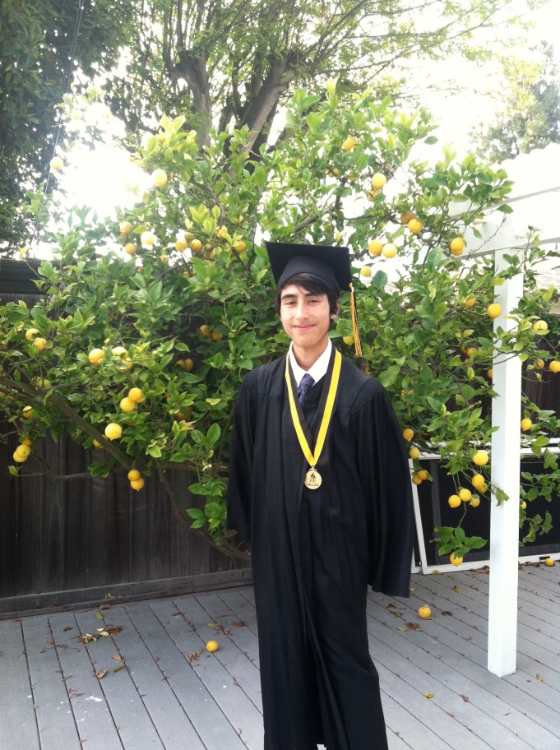
Any drug that is developed for treatment in research can be used to treat Marco under the FDA’s Compassionate Use Rule.
Expanded Access, sometimes called "compassionate use”, is the use of an investigational medical product outside of a clinical trial (i.e., one that has not been approved by FDA).

Slide 13
We know we are racing against time
Marco has recently needed to be in hospital for a long time with complications caused by this disease…..
He needs 24/7 care now
He watches soccer on TV, and stays optimistic and strong
Please help Marco to see his next Birthday! We are grateful for your donations!

Slide 14

Hang in there Marco!
We are putting out all efforts for you, and others to mend your wings and fly again!

